Slide 1
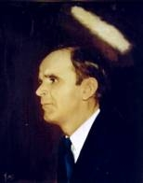

575
HE’S ON THE INSIDE
He’s on the inside
Of those pearly gates.
He’s on the inside of heaven,
There He waits.
He’ll call for me by name,
I’ll answer and I’ll go
To be with Him who died
And lives to love me so.

